Slide 1
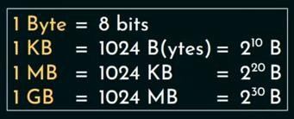
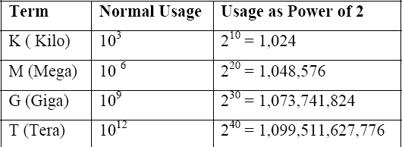
DMA - Problems
Problem 1:
A hard disk with a transfer rate of 20 Mbytes/second is constantly transferring data to memory using
DMA. The processor runs at 300MHz, and takes 300 and 900 clock cycles to initiate and complete
DMA transfer respectively. If the size of the transfer is 20 Kbytes, what is the percentage of processor time consumed for the transfer operation?
Solution:
Step 1: Find Total Transfer Time
Transfer rate=20 MB per second = 20 × 2²⁰ bytes/sec
𝑻𝒐𝒕𝒂𝒍 𝑫𝒂𝒕𝒂
𝑻𝒐𝒕𝒂𝒍 𝑻𝒊𝒎𝒆 =
𝑻𝒐𝒕𝒂𝒍 𝑻𝒓𝒂𝒏𝒔𝒇𝒆𝒓 𝑹𝒂𝒕𝒆
𝑪𝒚𝒄𝒍𝒆𝒔 𝒇𝒐𝒓 𝑫𝑴𝑨 𝒕𝒓𝒂𝒏𝒔𝒇𝒆𝒓
Data=20 KB=20 × 2¹⁰ bytes
𝑷𝒓𝒐𝒄𝒆𝒔𝒔𝒐𝒓 𝑻𝒊𝒎𝒆 =
𝑷𝒓𝒐𝒄𝒆𝒔𝒔𝒐𝒓 𝑺𝒑𝒆𝒆𝒅
Time=(20 × 2¹⁰)/(20 × 2²⁰)= 1 × 2⁻¹⁰ = 1 × 10⁻³ =1 ms
𝑷𝒓𝒐𝒄𝒆𝒔𝒔𝒐𝒓 𝑻𝒊𝒎𝒆
𝑻𝒐𝒕𝒂𝒍 𝑻𝒊𝒎𝒆
% 𝑷𝒓𝒐𝒄𝒆𝒔𝒔𝒐𝒓 𝑻𝒊𝒎𝒆 =
× 100
Step 2 :Find Processor Time
1 MHz = 10⁶ cycles/sec
Processor speed= 300 MHz = 300 × 10⁶ Cycles/sec
Cycles required by CPU for DMA Transfer =300+900 =1200 cycles Time=1200 cycles/(300 × 10⁶) cycles/sec = 4 ×10 ⁻⁶ sec = .004 ms
Step 3 : Find % of Processor Time
% Processor Time = (.004/1) × 100 = 0.4%

Slide 2
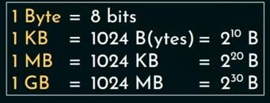
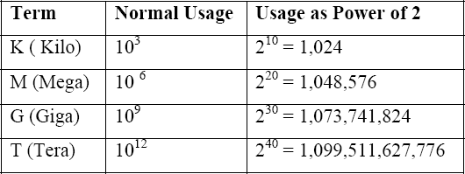
DMA - Problems
Problem 2:
A hard disk with a transfer rate of 10 Mbytes/second is constantly transferring data to memory using
DMA. The processor runs at 600MHz, and takes 300 and 900 clock cycles to initiate and complete
DMA transfer respectively. If the size of the transfer is 20 Kbytes, what is the percentage of processor time consumed for the transfer operation?
Solution:
Step 1: Find Total Transfer Time
Transfer rate=10 MB per second = 10 × 2²⁰ bytes/sec
𝑻𝒐𝒕𝒂𝒍 𝑫𝒂𝒕𝒂
𝑻𝒐𝒕𝒂𝒍 𝑻𝒊𝒎𝒆 =
𝑻𝒐𝒕𝒂𝒍 𝑻𝒓𝒂𝒏𝒔𝒇𝒆𝒓 𝑹𝒂𝒕𝒆
𝑪𝒚𝒄𝒍𝒆𝒔 𝒇𝒐𝒓 𝑫𝑴𝑨 𝒕𝒓𝒂𝒏𝒔𝒇𝒆𝒓
Data=20 KB=20 × 2¹⁰ bytes
𝑷𝒓𝒐𝒄𝒆𝒔𝒔𝒐𝒓 𝑻𝒊𝒎𝒆 =
𝑷𝒓𝒐𝒄𝒆𝒔𝒔𝒐𝒓 𝑺𝒑𝒆𝒆𝒅
Time=(20 × 2¹⁰)/(10 × 2²⁰)= 2 × 2⁻¹⁰ = 2 × 10⁻³ = 2 ms
𝑷𝒓𝒐𝒄𝒆𝒔𝒔𝒐𝒓 𝑻𝒊𝒎𝒆
𝑻𝒐𝒕𝒂𝒍 𝑻𝒊𝒎𝒆
% 𝑷𝒓𝒐𝒄𝒆𝒔𝒔𝒐𝒓 𝑻𝒊𝒎𝒆 =
× 100
Step 2 :Find Processor Time
1 MHz = 10⁶ cycles/sec
Processor speed= 600 MHz = 600 × 10⁶ Cycles/sec
Cycles required by CPU for DMA Transfer =300+900 =1200 cycles Time=1200 cycles/(600 × 10⁶) cycles/sec = 2 ×10 ⁻⁶ sec = .002 ms
Step 3 : Find % of Processor Time
% Processor Time = (.002/2) × 100 = 0.1%

Slide 3

Performance Metrics
Elapsed time/Response Time
The time between the start and completion of a task.
It includes time spent executing on the CPU, accessing disk and memory, waiting for I/O and other processes, and operating system overhead.
A useful number – but often not good for comparison purposes.

Slide 4

Performance Metrics
CPU Execution Time/CPU Time/Processing Time
Total time a CPU spends computing on a given task (excludes time for I/O or running
other programs).
Doesn’t count waiting for I/O or time spent running other programs.
User CPU time - CPU time spent in the program
System CPU time - CPU time spent in the operating system
Throughput of a CPU/Bandwidth
The total amount of work done in a given time.
another measure of performance -number of tasks (Quantity) completed per unit time.

Slide 5
Performance Metrics
MIPS
Millions of instructions per second
MFLOPS
Millions of floating point operations(FLO) per second

Slide 6
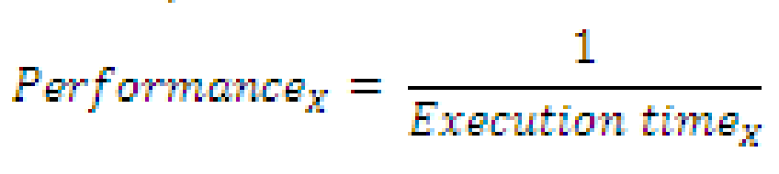
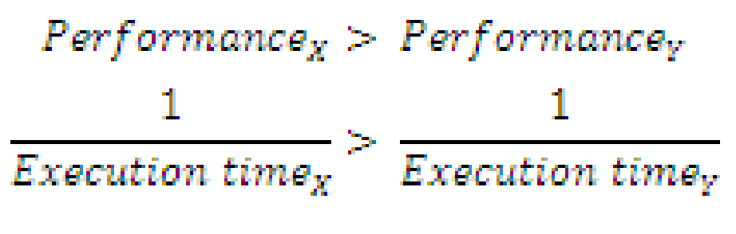
Performance Metrics
To maximize performance, we want to minimize response time or execution time for task. Thus, we can relate performance and execution time for a computer X:
This means that for two computers X and Y, if the performance of X is greater than the performance of Y, we have
That is, the execution time on y is longer than X, so X is faster than Y.

Slide 7
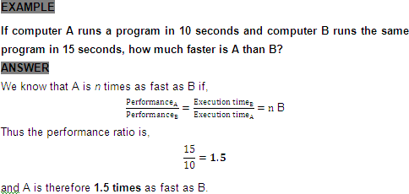
Performance Metrics - Example
Performance_{A} = n × Performance_{B}

Slide 8
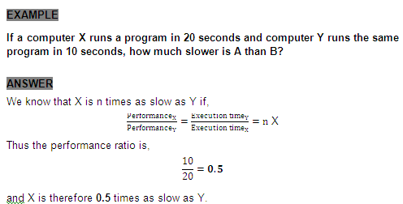
Performance Metrics - Example
Hint : Performance (X) < Performance (Y)
Performance_{X} = n × Performance_{Y}

Slide 9

Performance Metrics
For some program running on machine X,
Performance =
1
Execution time(X)
"X is n times faster than Y" – represented as
Performance(X) _{= n}
Performance(Y)
Problem: Machine A runs a program in 20 seconds. Machine B runs the same program in 25 seconds. How many times faster is machine A?

Slide 10
Computer Clock
Almost all computers are constructed using a clock that determines when events take place in the hardware.
These discrete time intervals are called clock cycles (ticks, clock ticks, clock periods, clocks, cycles).
clock period
Designers refer to the length of a clock period in time for a complete clock cycle (e.g., 250 picoseconds) and as the clock rate/frequency (e.g. 4 GHz, 5 MHz), which is the inverse of the clock period.

Slide 11
Computer Clock
Clock cycle time - the amount of time for one clock period to elapse (e.g. 5 ns, 250 picoseconds….).
Clock rate/frequency- inverse of the clock cycle time.
For example, if a computer has a clock cycle time of 5 ns, the clock rate is:
1
---------------------- = 200 MHz
5 x 10⁻⁹ sec
clock period

Slide 12

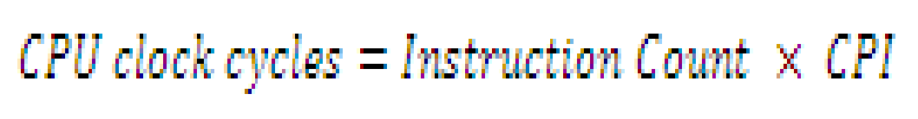

Processor Performance Equation
Performance Equation:
Alternatively
Also, execution time - depend on the number of instructions in a program
Execution time equals the number of instructions executed multiplied by the average time per instruction. Therefore, the number of clock cycles required for a program can be written as
Clock cycles per instruction (CPI), which is the average number of clock cycles for each instruction takes to execute, is often abbreviated as CPI.

Slide 13
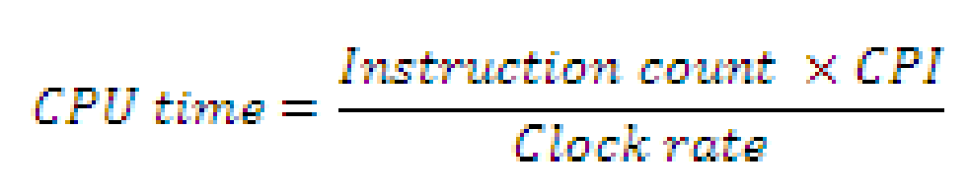
Processor Performance Equation
Since different instructions may take different amounts of time depending on what they do, CPI is an average of all the instructions executed in the program.
The basic performance equation can be rewritten in terms of instruction count, that is, number of instructions executed by the program, CPI and clock rate.

Slide 14
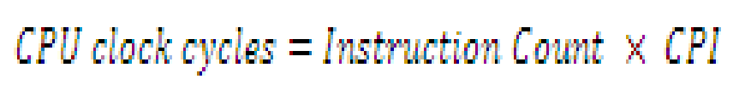


Processor Performance Equation
To Summarize,
1
𝐶𝑙𝑜𝑐𝑘 𝑅𝑎𝑡𝑒 =
𝑐𝑙𝑜𝑐𝑘 𝑐𝑦𝑐𝑙𝑒 𝑇𝑖𝑚𝑒
CPI (cycles per instruction)
A floating point intensive application might have a higher CPI

Slide 15
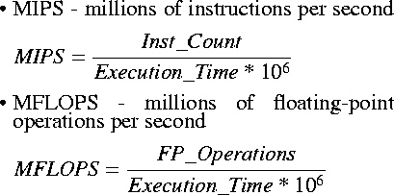
MIPS & MFLOPS

Slide 16
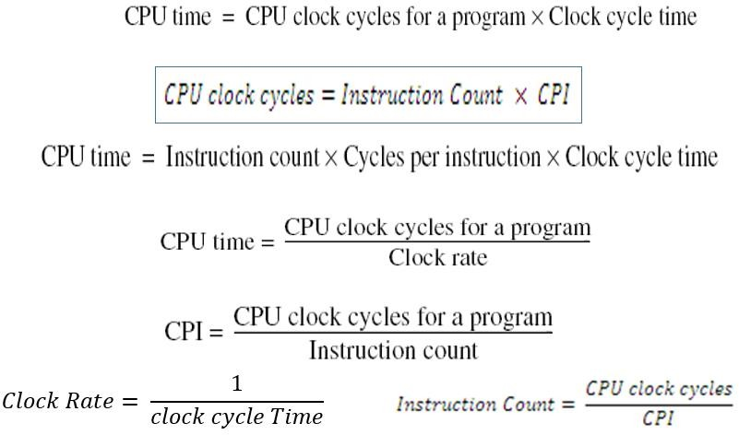
Practice Problems
Example 1:
CPU clock rate is 1 MHz
Program takes 45 million cycles to execute
What’s the CPU time?
45,000,000 * (1 / 1,000,000) = 45 seconds

Slide 17
Practice Problems
Example 2:
CPU clock rate is 500 MHz
Program takes 45 million cycles to execute
What’s the CPU time?
45,000,000 * (1 / 500,000,000) = 0.09 seconds

Slide 18
Practice Problems
Example 3:
Suppose we have two implementations
of the same instruction set architecture (ISA).
For some program,
Machine A has a clock cycle time of 10 ns. and a CPI of 2.0
Machine B has a clock cycle time of 20 ns. and a CPI of 1.2
Which machine is faster for this program, and by how much?
Assume that # of instructions in the program is 1,000,000,000.

Slide 19

Practice Problems
Example 3: Solution
Machine A has a clock cycle time of 10 ns. and a CPI of 2.0 Machine B has a clock cycle time of 20 ns. and a CPI of 1.2 # of instructions - 1,000,000,000.
CPU / Execution Time_{A} = 10⁹ * 2.0 * 10 * 10⁻⁹ = 20 seconds
CPU/ Execution Time_{B} = 10⁹ * 1.2 * 20 * 10⁻⁹ = 24 seconds
= 24/20 = 1.2 times
Machine A is faster

Slide 20
Practice Problems
Example 4:
Our favorite program runs in 10 seconds on computer A, which has a 2 GHz clock. We are trying to help a computer designer build a computer, B, which will run this program in 6 seconds. The designer has determined that a substantial increase in the clock rate is possible, but this increase will affect the rest of the CPU design, causing computer B to require 1.2 times as many clock cycles as computer A for this program. What clock rate should we tell the designer to target?

Slide 21
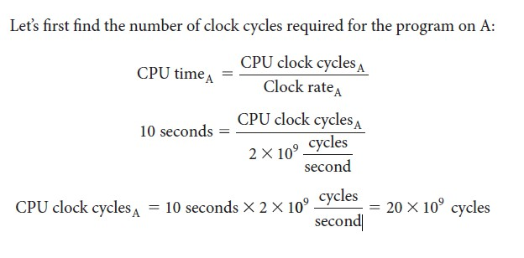
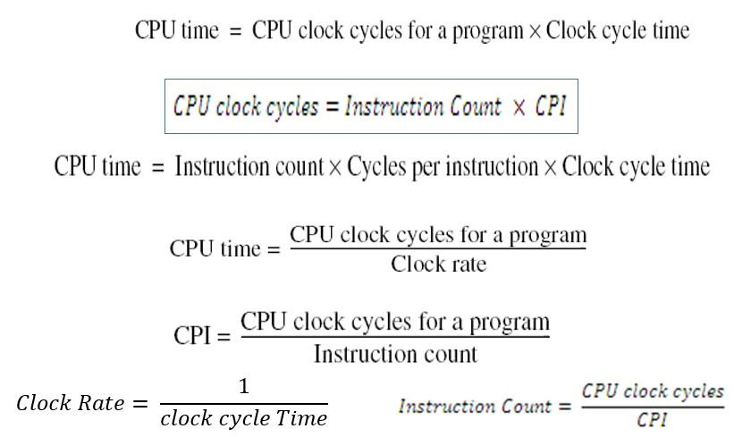
Practice Problems
A – Exec time = 10 sec, Clock rate – 2GHz B- Exec.time = 6 sec.
Clock cycle of B = 1.2 (clock cycle of A)
Find Clock rate of B?
Example 4: Solution

Slide 22
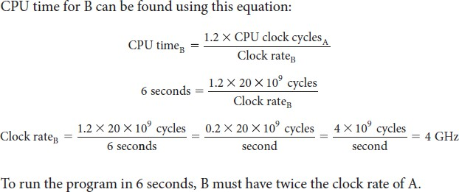
Practice Problems
A – Exec time = 10 sec, Clock rate – 2GHz B- Exec.time = 6 sec.
Clock cycle of B = 1.2 (clock cycle of A)
Find Clock rate of B?
Example 4: Solution

Slide 23
Practice Problems
Example 5:
Suppose we have two implementations of the same instruction set architecture. Computer A has a clock cycle time of 250 ps and a CPI of
2.0 for some program, and computer B has a clock cycle time of 500 ps and a CPI of 1.2 for the same program. Which computer is faster for this program and by how much?

Slide 24
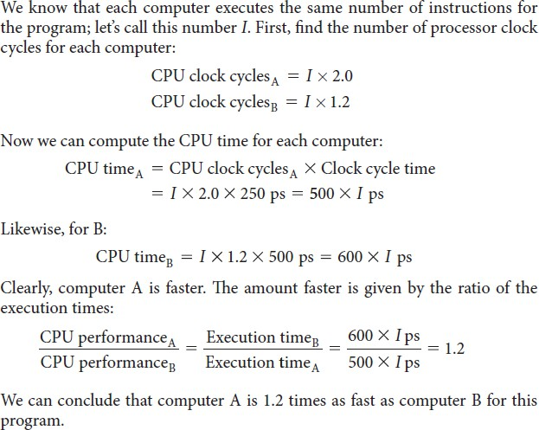
Practice Problems
Example 5: Solution

Slide 25

Average Cycles per Instruction
∑𝑛
𝐼C ∗𝐶𝑃𝐼𝑖
Total CPI= ^{𝑖=1 𝑖}
Instruction count(Ic)

Slide 26
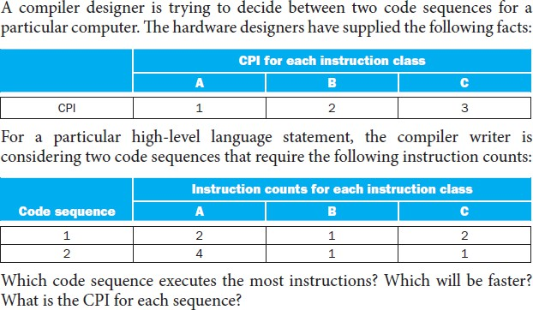
Practice Problems
Example 6:

Slide 27
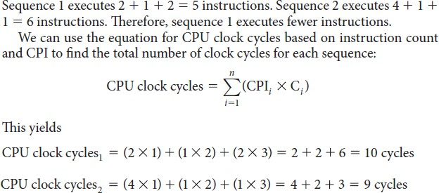
Practice Problems
Example 6: Solution
B is faster
Since Clock cycle time is not given, we can estimate using CPU clock cycles itself

Slide 28
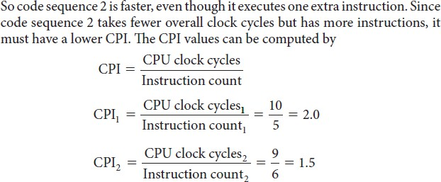
Practice Problems
Example 6: Solution

Slide 29
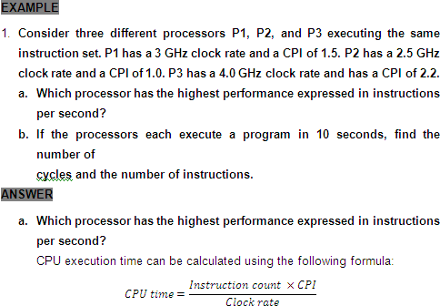
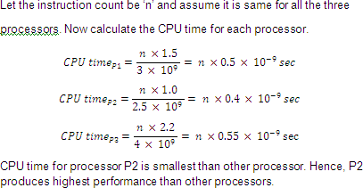
Practice Problems
Example 7:

Slide 30
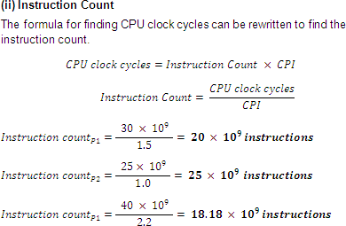
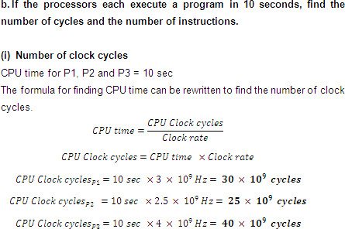
Practice Problems
Example 7: Solution

Slide 31
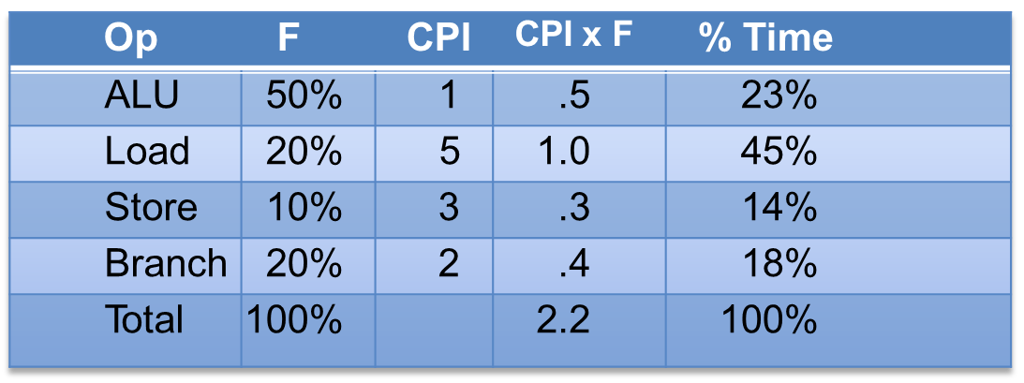
With Frequency
CPI=
CPU clock cycles(c)
Instruction count(Ic)
∑𝑛
𝐼C ∗𝐶𝑃𝐼𝑖
Total CPI= ^{𝑖=1 𝑖}
Instruction count(Ic)
The CPI is the average number of cycles per instruction.
If for each instruction type, we know its frequency and number of cycles need to execute it, we can compute the overall CPI as follows:
CPI= ∑^{𝑛} Freq
∗ 𝐶𝑃𝐼
𝑖=1
i
𝑖

Slide 32
Practice Problems
Example 8: Solution
Let assume that a benchmark has 100 instructions:
25 instructions are loads/stores (each take 2 cycles)
50 instructions are adds (each takes 1 cycle)
25 instructions are square root (each takes 50 cycles)
What is the CPI for this benchmark?
Frequency
CPI
CPI= ∑^{𝑛}
Freq_{i} ∗ 𝐶𝑃𝐼_{𝑖}
𝑖=1
CPI = ((0.25 * 2) + (0.50 * 1) + (0.25 * 50))
= 13.5

Slide 33
Practice Problems
Example 9:
Two different compilers are being tested for a 500 MHz. machine with three different classes of instructions: Class A, Class B, and Class C, which require one, two, and three cycles (respectively).
Both compilers are used to produce code for a large piece of software.
The first compiler's code uses 5 billions Class A instructions, 1 billion Class B instructions, and 1 billion Class C instructions.
The second compiler's code uses 10 billions Class A instructions, 1 billion Class B instructions, and 1 billion Class C instructions.
Which sequence will be faster according to MIPS?
Which sequence will be faster according to execution time?

Slide 34
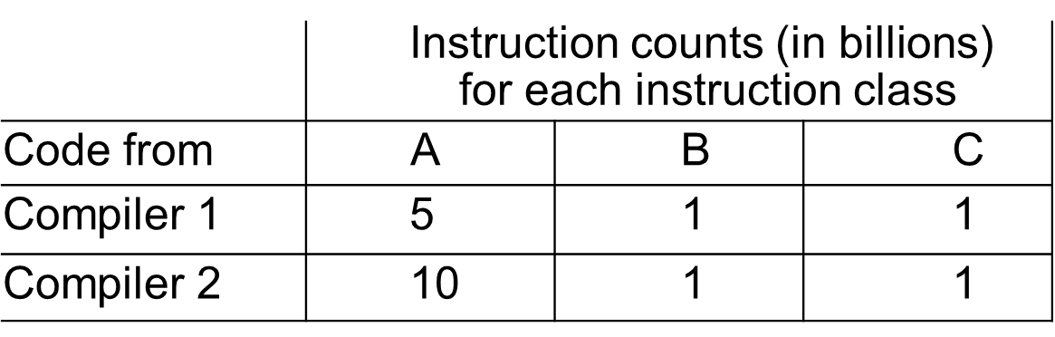
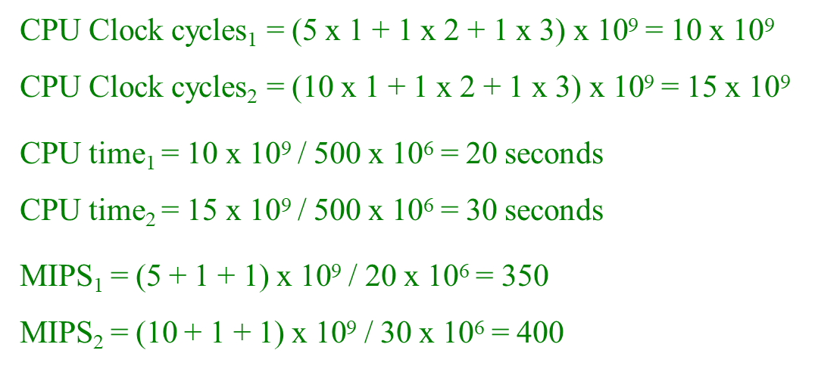

Practice Problems
Example 9: Solution
Clock rate – 500 MHz Cycles – class1-1 cycle,
class2-2 cycles, class3-3 cycles.

Slide 35
Problems with Arithmetic Mean
For example, two machines timed on two benchmarks:
 | Machine A | Machine B
Program 1 Program 2 | 2 seconds (20%) 12 seconds (80%) | 6 seconds (20%) 10 seconds (80%)
Average execution time_{A} = (2 + 12) / 2 = 7 seconds
Average execution time_{B} = (6 + 10) / 2 = 8 seconds
Weighted average execution time_{A} = 2*0.2 + 12*0.8 = 10 seconds Weighted average execution time_{B} = 6*0.2 + 10*0.8 = 9.2 seconds

Slide 36

MIPS rate
A common measure of performance for a processor is the rate at which instructions are executed, expressed as millions of instructions per second (MIPS), referred to as the MIPS rate.
Ic → Instruction count
T→ CPU time
f→Clock rate
CPI→ Cycles Per Instruction
𝐼𝑐 ∗ 𝑓
CPU clock cycles ∗ 10⁶

Slide 37
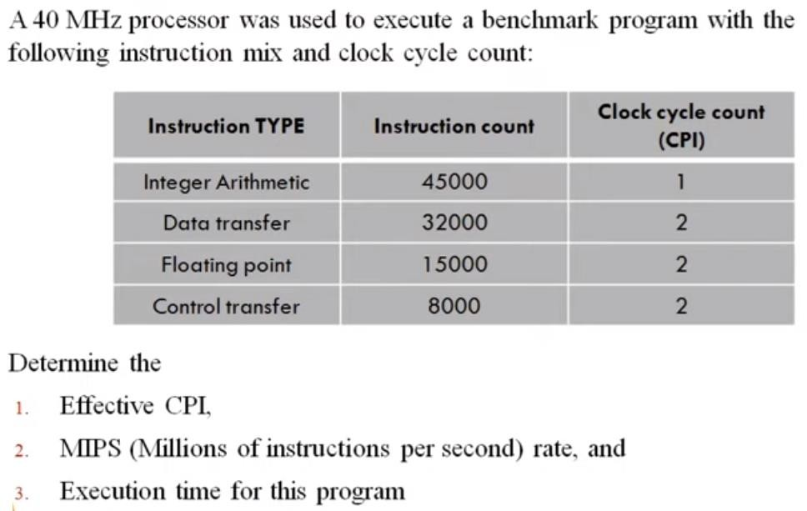
Practice Problems
Example 10:

Slide 38
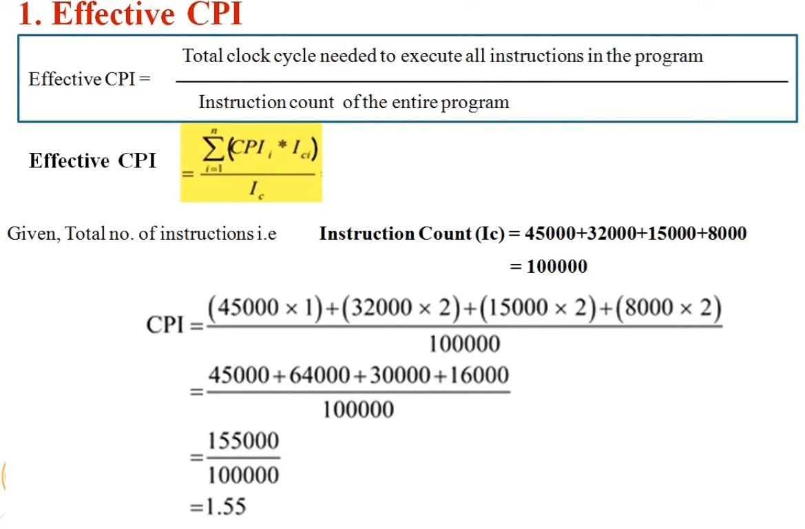
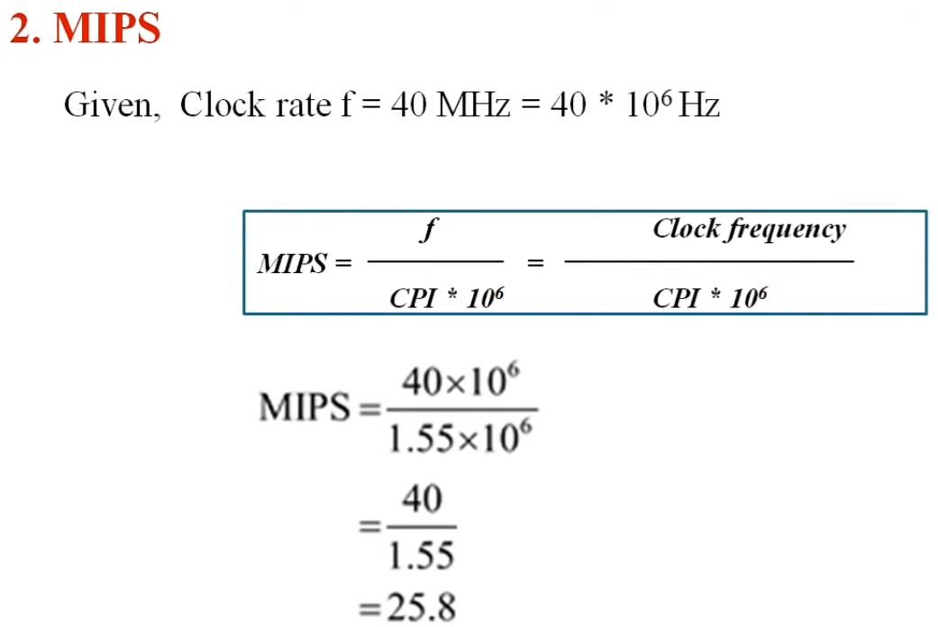
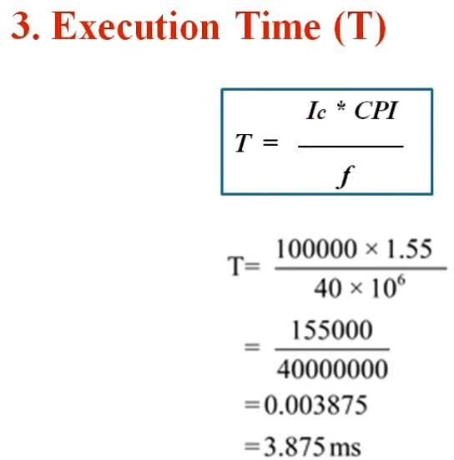

Slide 39
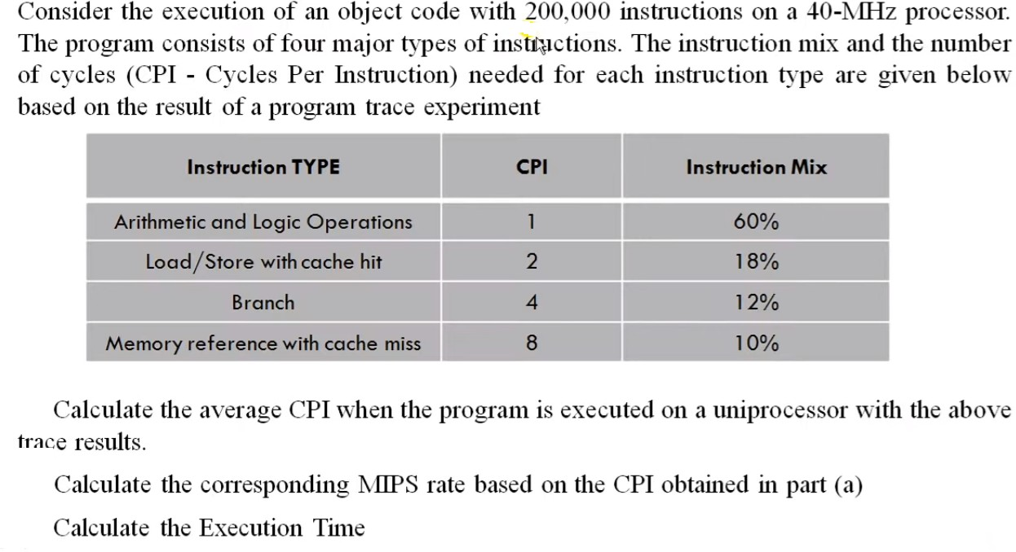
Practice Problems
Example 11:

Slide 40
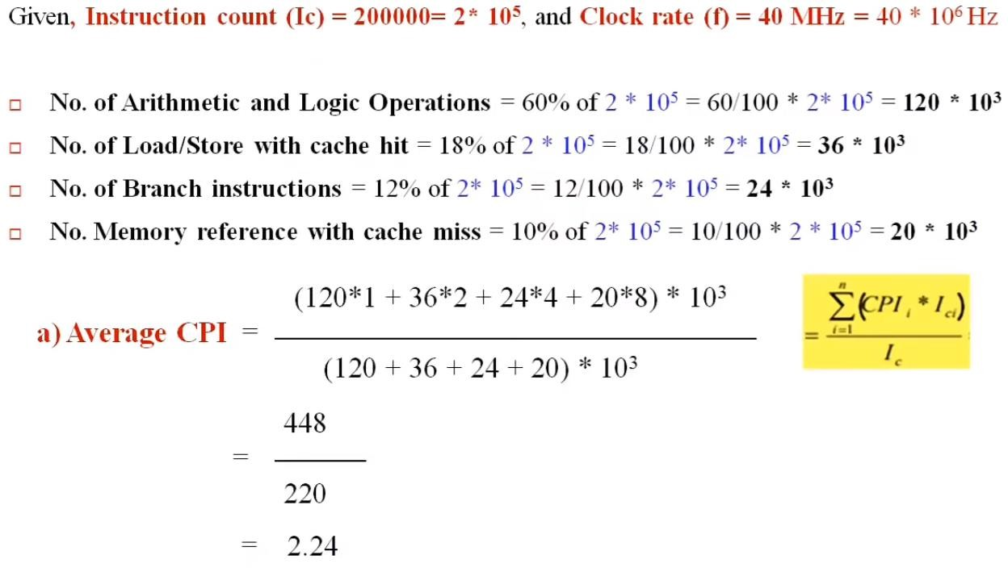
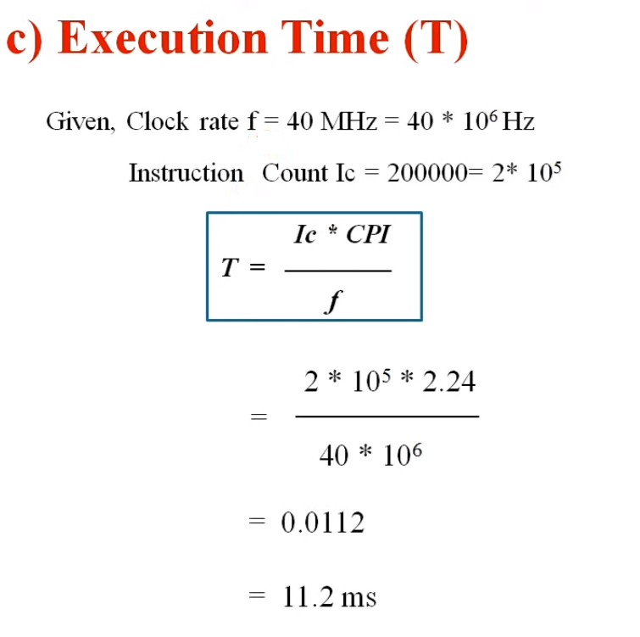
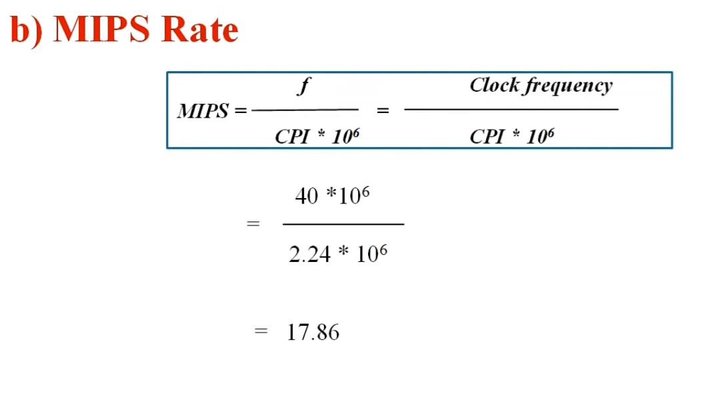

Slide 41
Example 12:
Assume that a benchmark has 100 instructions with the clock rate of 300Mhz. 20% instructions are loads/stores (each take 3 cycles), 40% instructions are adds (each takes 2 cycles), and 40% instructions are square root (each takes 60 cycles), what is the CPI and MIPS rate for this benchmark?
Ans: CPI=25.4 , MIPS=11.8

Slide 42
MFLOPS
Floating-point performance is expressed as millions of floating-point operations per second (MFLOPS), defined as follows:

Slide 43
